Slide 1
ASSIGNMENT #1
Measures of Central Tendency

Slide 2
Function
Functions can accept more than one input arguments and may return more than one output arguments.
Syntax:
function [out1,out2, ..., outN] = my_fun(in1,in2,in3, ..., inN)
.
.
.
end

Slide 3
Quartiles
Compute the Q1,Q2,Q3 for the following data.

Slide 4
Function
function [] = Quartiles(X)
end

Slide 5
Output of Quartiles

Slide 6
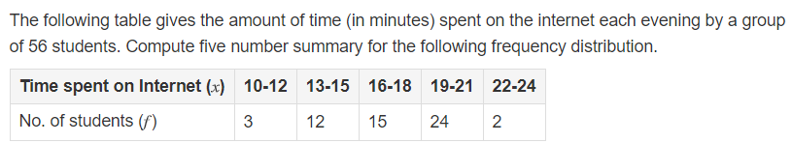
For Grouped data : Quartiles
Compute the Q1,Q2,Q3 for the following data.

Slide 7
Function
function [] = Quartiles()
end

Slide 8
Output of Quartiles

Slide 9
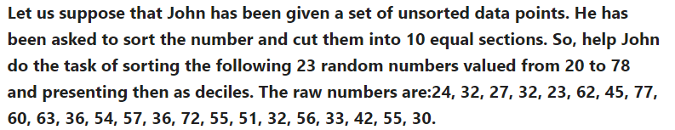
Deciles
Compute the D1,D2……D10 for the following data.

Slide 10
Function
function [] = Decile()
end

Slide 11
Output of Decile

Slide 12
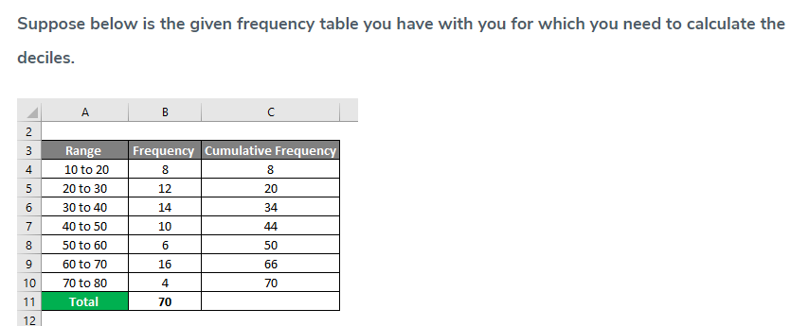
Grouped Deciles
Compute the D1,D2……D10 for the following data.

Slide 13
Function
function [] = Decile()
end

Slide 14
Output of Decile

Slide 15
Percentile
Compute the p1,p2,….p100 for the following data.
NOTE:
Consider random 40 numbers

Slide 16
Function
function [] = percentile(X)
end

Slide 17
Output of Percentile

Slide 18
Grouped Percentile
Compute the p1,p2,….p100 for the following data.

Slide 19
Function
function [] = percentile(X)
end

Slide 20
Output of Percentile

